Slide 1



Survey of female
A-level students:
- sense of purpose
- sense of belonging
- and hedging
Lynne Blair
Lisa Thomas
Emily Winter
Lancaster University

Slide 2
Background
Method
Findings
Conclusions

Slide 3
Background
some statistics
some impacts

Slide 4


The statistics: Percentages of females …
21.4%
GCSE, 2019
JCQ
13.3%
A-level 2019, JCQ
17%
Tech workforce, 2019
BCS
17.2%
UG, 2019
HESA
Notes:
% of women at various stages:
17% women in the tech workforce – BCS press office, March 2019
21.4% females GCSE Computer Science – JCQ = Joint Council for Qualifications
13.3% females A-level Computer Science – JCQ
17.2% women studying CS at UG level, HESA, Jan 2019

Slide 5
Impacts on all aspects of technology, including…
legal & ethical concerns re:
gender and racial biases in
AI/ machine-learning algorithms
and
impact on women entering CS education and the workplace
Notes:
Impacts:
Biases (gender and racial) in CS design in general, and specifically AI/ machine learning algorithms
Impact on women entering CS education and workforce (‘locker-room’ talk)
Persisting stereotypes of CS as a masculine discipline puts off otherwise interested and competent women.

Slide 6
Method
who offers A-level Computer Science in Lancashire?
what responses could we expect?
visual, paper-based questionnaire

Slide 7
Lancashire – who offers A Level CS?
The Roehampton Annual Computing Education Report
June 2018, p.56. Peter Kemp, Miles Berry, Billy Wong
Based on this data, we could expect 17 providers and 195 students
Notes:
https://cdn.bcs.org/bcs-org-media/3972/tracer-2017.pdf. Note this report was the full 2018 report, that uses data collected in 2017
I’ve edited the table to just show Lancashire – towards the bottom of the list of the top 30 providers – sorted by student uptake - 195 = m+f
We used combinations of local authority maintained schools, colleges, academies, etc. We didn’t get full list of independents offering CS, e.g. CS filter for https://www.compare-school-performance.service.gov.uk/schools-by-type?step=default&table=schools&region=888&la-name=lancashire&geographic=la&for=16to18&datasetfilter=final
Coming next: providers without females

Slide 8
Lancashire – who offers A Level CS?
The Roehampton Annual Computing Education Report
4 providers replied to us to say they had no females doing A-level – but we could expect ~11 (of 17) providers to have no CS females
we had surveys returned from 6 providers
Notes:
Table 8 suggests that 66.3% of providers have NO female students => so we could expect ~11 of 17 to have no females studying CS
i.e. ~6 providers would have females (based on 2017 data and national averages from table 8)
Note this table is for mixed providers – and since we had one all girls school respond, that will skew the responses and number of females
Coming next: how many females

Slide 9
Lancashire – who offers A Level CS?
The Roehampton Annual Computing Education Report
And how many females?
Table 15 identifies 195 A-level students studying CS in Lancashire
Here, something is odd … national % suggests 13.3% females
We received 56 replies (cf. 13.3% of 195 = 25.9)
Possible explanations?
    Old (2017) data (cf. our data collected in summer 2019)
    Higher than average uptake across the NW
    Girls school – skewed numbers (not mixed)
Notes:
Table 8 suggests that 66.3% of providers have NO female students => we could expect 66.3% of 17 = 11.27 to have no females
i.e. ~6 providers would have females (based on 2017 data and national averages from table 8)
195 students – 13.3% is national average = 25.9 students
Coming next: questionnaire

Slide 10
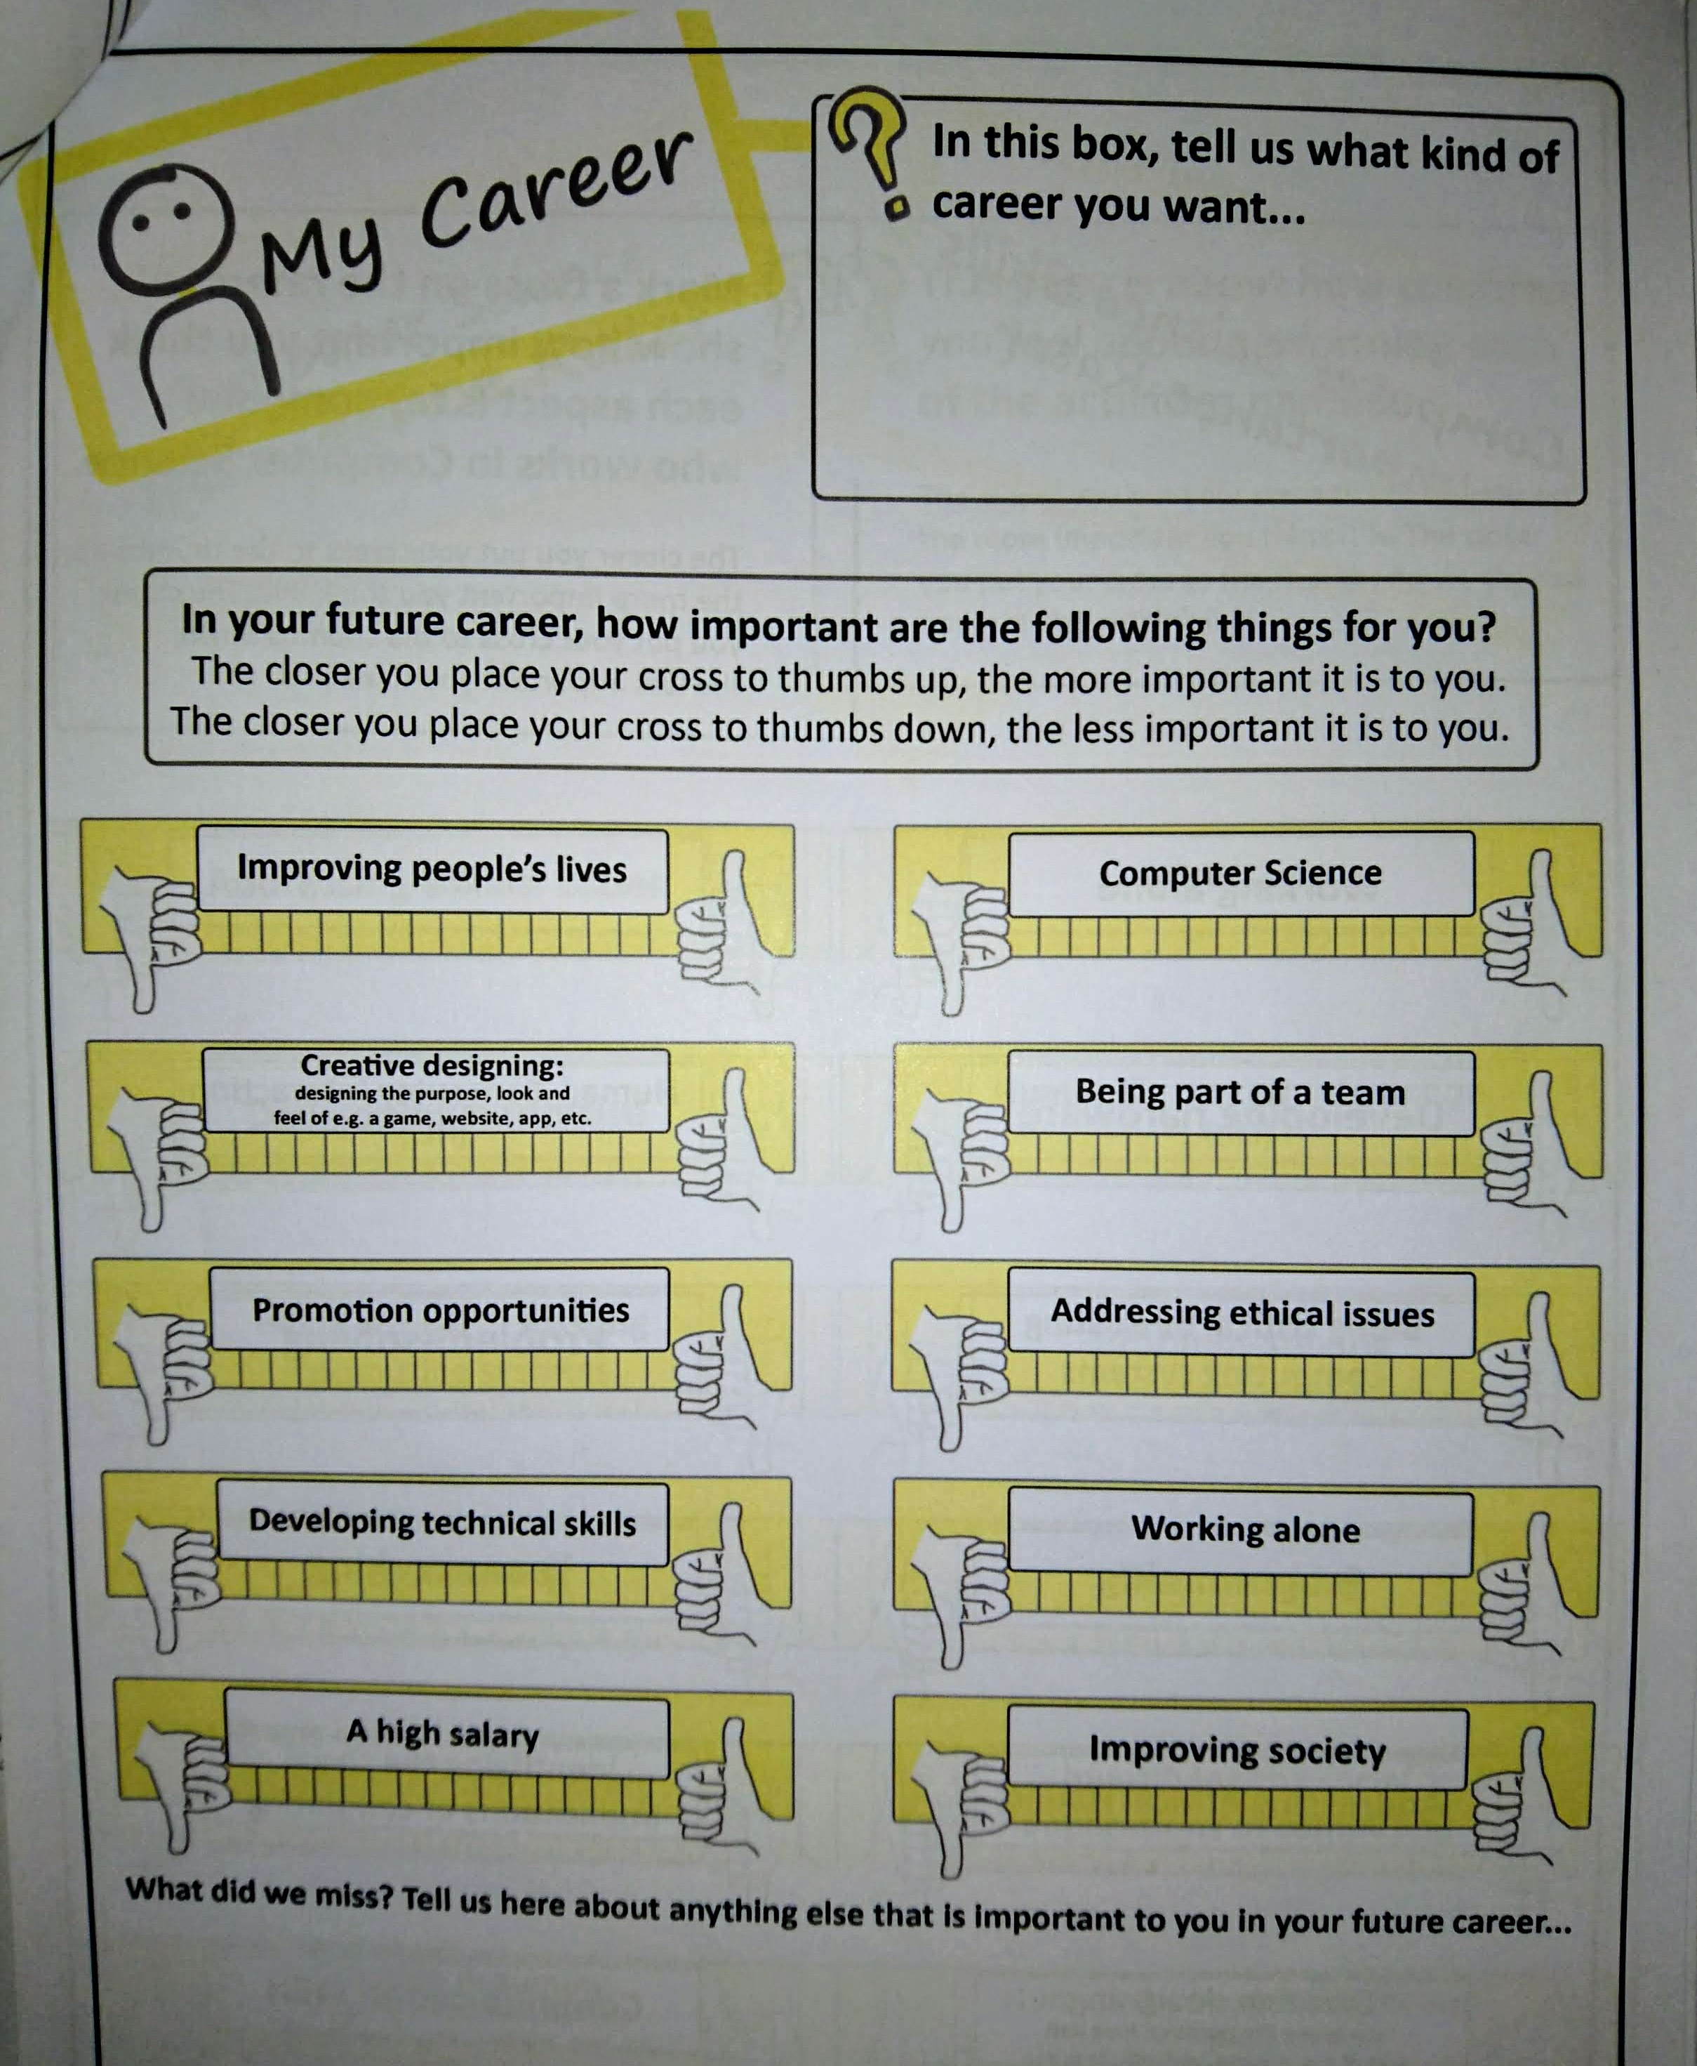
Questionnaire
Visual, paper-based questionnaire
Questions included:
What aspects of your future career are important for you (including values)
What skills do you perceive as important for someone working in CS

Slide 11
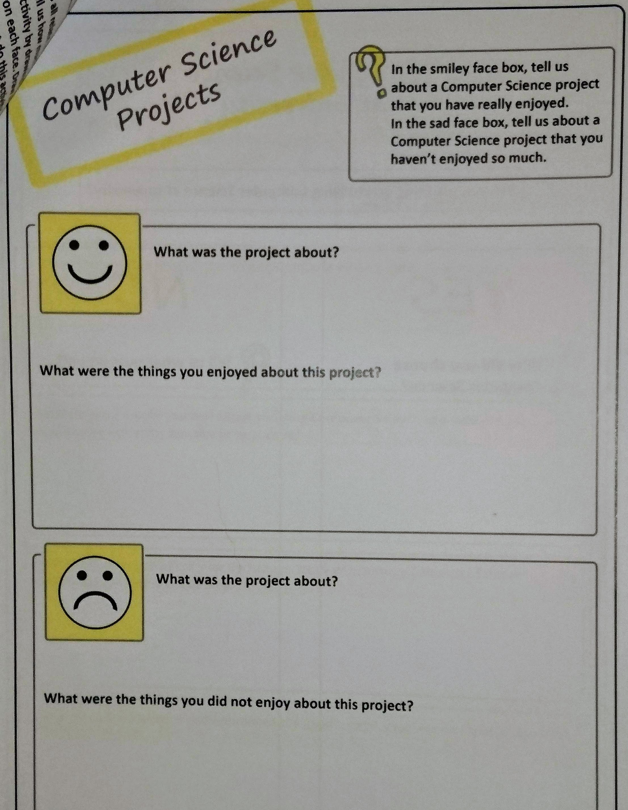
Questionnaire
Visual, paper-based questionnaire
Questions included:
Projects – what were the things you enjoyed/ did not enjoy about different projects
  How confident are you about performing different named activities

Slide 12
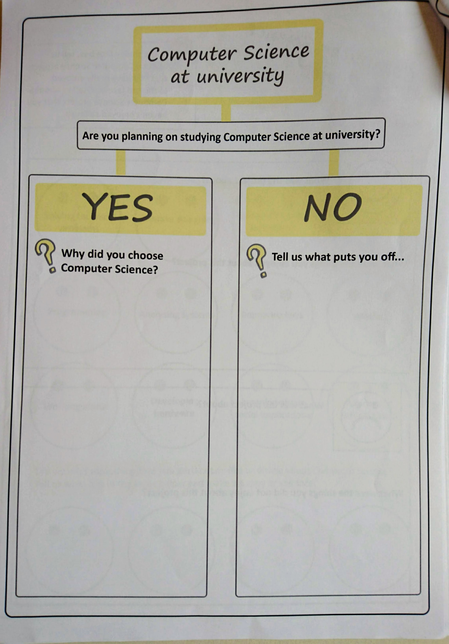
Questionnaire
Visual, paper-based questionnaire
Questions included:
Reasons for wanting to continue studying Computer Science or what puts you off?
How do you feel/would you feel … different questions including on the gender gap

Slide 13
Questionnaire
Visual, paper-based questionnaire – ‘mechanics’
Email and/or phone contact with the CS teacher
Teachers distribute the questionnaires, participant information sheets and consent forms
Participation was voluntary
Classroom collection boxes or stamped envelopes provided so that responses did not need to go back to teacher
Thematic analysis on the data

Slide 14
Findings
sense of social purpose
sense of belonging
hedging

Slide 15
Important aspects for your career …
Weighted responses (0 for none/low, 1 for medium, 2 for high)
Developing technical skills (105)
Improving people’s lives (100)
Improving society (97)
Being part of a team (93)
A high salary (89)
Creative designing (63)
Working alone (63)
Notes:
Second and third => sense of social purpose

Slide 16
Projects – open responses …
Making a difference (R22)
Real-world users and realistic situations (R47)
Cited examples of real-world projects included:
Staff movement in a hospital (R5), voting machine (h/ware & s/ware) for school (R7), encrypted booking system for local music school (R17), charity shop stock system (R20), NHS medical records system (R27), dyslexia screening (R37), …
=> sense of social purpose
Notes:
Consistent with career feedback:
Improving people’s lives
Improving society

Slide 17
Projects – open responses …
However, a small number of respondents saw a disconnect between CS and a sense of purpose:
A CS career is not helping people in need and is not a caring career (R10)
I want to impact on people’s lives (social action) and I don’t think this can be done with CS and, if it can, I haven’t been educated how to (R15)
=> not sense of social purpose?

Slide 18
Studying CS further … & gender gap
Sense of belonging:
important predictor of success and retention
Linda Sax et al. 2018, Katherine Rainey et al. 2018.
From a social perspective, it would be nice to have more people you can easily relate to (R3)
I thought I wanted to do CS until I studied it at A-level… [but] I don’t feel as if I would fit in (R49)
=> no sense of belonging?
Notes:
Full quote: I thought I wanted to do CS until I studied it at A-level.
I know this is a generalisation, but I associate certain stereotypes with computer scientists
and I have found that many students I have spoken to who are/ planning to take it at Uni are very similar and I don’t feel as if I would fit in (R49)

Slide 19
Studying CS further … & gender gap
Gender gap issues included:
I wasn’t expecting to be the only girl in my class (R49, similarly R19, R21)
Negative words/ phrases included:
4 x intimidated
3 x uncomfortable, worried
2 x disconcerted, scared, out of place
1 x strange, unexpected, isolating, difficult, weird,
needing to be brave, sad that some girls may be put off
=> no sense of belonging?
Notes:
Not the sort of words you would typically associate with a sense of belonging?

Slide 20
Studying CS further … & gender gap
Gender gap positives included:
It may be an advantage to be a woman in CS (R44) and I would feel more unique (R30).
Girls who enter pave the way for decreasing the gap (R27, similarly R35)
Notes:
Coming next: Persistence and resilience

Slide 21
Studying CS further … & gender gap
Determination and resilience:
I was determined to take it because I love it (R17)
I have to work harder than men to gain men’s respect. I will not let this prevent me from studying CS […] and I’m not going to stop pursuing my ideal career (R18, similarly R35)
You get treated differently … it’s almost like men feel threatened by you. You constantly have to work to earn their respect in a way that male peers do not (R20)
Notes:
We’ve seen that a few positives stood out, like uniqueness, standing out, paving the way,
Plus significant examples of determination and resilience, in spite of a small number of examples of a perceived difference in treatment between males and females
but still no sense of belonging?
Although many comments had negative elements … there were a lot of ‘buts’ or equivalent (hedging)

Slide 22
Sense of belonging … & ‘hedging’
When faced with negative feelings, many respondents were quick to add a diminishing clause
- this was clearly displayed in at least 20 responses:
Uncomfortable, but would get used to it (R12)
but wouldn’t worry too much (R15)
but would not mind (R39)
but would still do it if I wanted to (R48)
Out of place, but would still enjoy it (R24)
Isolated at first but once I’ve made friends, I think I’d be ok (R25)
Intimidated but it might make me persevere more (R49)

Slide 23
So what is this ‘hedging’
Linguistic device – found by socio-linguistics to be more common in the way in which women speak and present themselves
It’s a bit weird, but it’s not a problem
In most of our cases, respondents are conscious of protecting themselves as well as others, diminishing the negatives.
Note: Murphy identifies lots of other forms of hedging that serve a wide range of purposes (ch 4)
Notes:
In our context, not clear that this is female vs male – or minority vs majority group
https://books.google.co.uk/books?id=FKAveyWyW2sC&pg=PA56&lpg=PA56&dq=hedging+murphy+Corpus+and+Sociolinguistics+Investigating+age+and+gender+in+female+talk&source=bl&ots=tJn0aBABqH&sig=ACfU3U2MR-rpFgNWI8rd0bw_h15SbsowWA&hl=en&sa=X&ved=2ahUKEwiLyfenp8PoAhWSoXEKHbqzDZgQ6AEwCnoECAsQAQ#v=onepage&q=hedging%20murphy%20Corpus%20and%20Sociolinguistics%20Investigating%20age%20and%20gender%20in%20female%20talk&f=false
Google books preview

Slide 24
Conclusions
our survey was of those students already doing CS at A-level
had already developed a level of resilience and a ‘way of being’
clear sense of purpose
fragile sense of belonging
lots of hedging – including a self-responsibility to adapt, fit in and succeed
Challenge to us all
OUR responsibility (at departmental/ institutional levels) to adapt
Notes:
already developed resilience and a way of being in a male dominated world

Slide 25
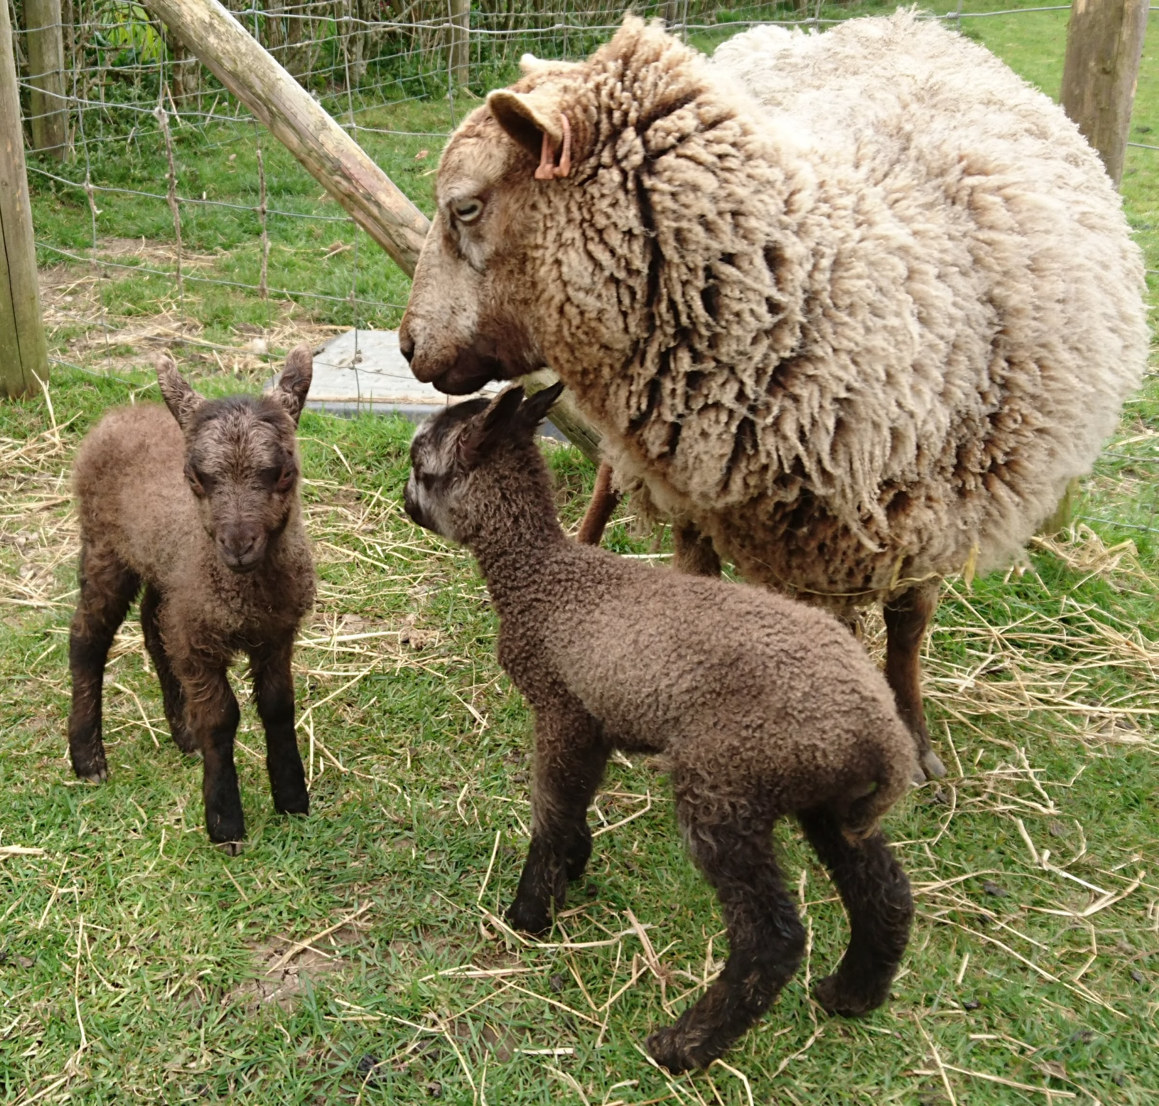
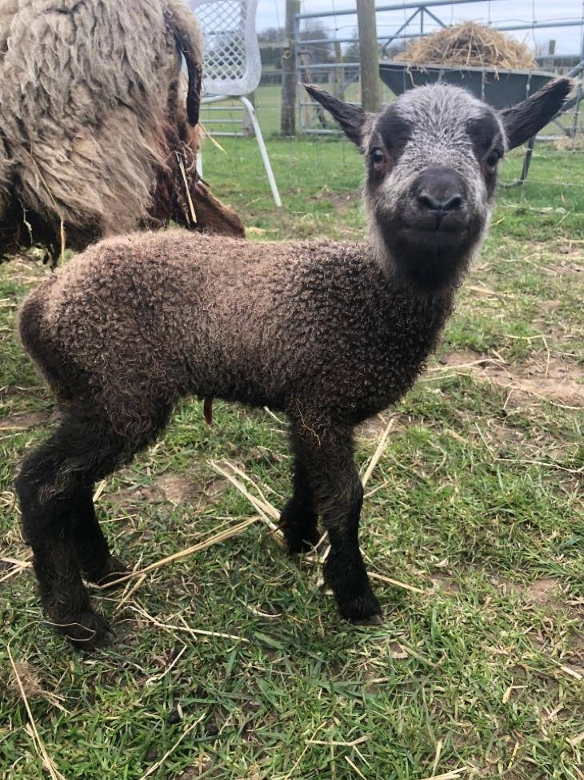
Any questions?
You can contact us at:
l.blair@lancaster.ac.uk
l.thomas@lancaster.ac.uk
e.winter@lancaster.ac.uk

