Slide 1

Please help us with our research
https://www.surveymonkey.co.uk/r/ResearchPlacementsOutreach
Do you
Teach computing
Develop computing resources (including CPD)
Work in initial teacher training (secondary CS or primary)
Undertake CS education research
Run CS university modules with school placements
Provide CS outreach
How teachers engage with research?
How schools engage with universities and vice versa?
Survey by Computing At School Research Working Group, BCS, Raspberry Pi Foundation, Council of Professors and Heads of Computer science (CPHC), Queen Mary University of London

Slide 2
#CSEdResearchBookClub
https://www.surveymonkey.co.uk/r/ResearchPlacementsOutreach
Every 1st Thursday of the Month
Twitter and trying a hangout and a collaborative google doc this month
This months read
Identifying student misconceptions of programming (Kaczmarczyk et al. 2010) http://publish.illinois.edu/glherman/files/2016/03/2010-SIGCSE-Programming-Misconceptions.pdf
Next month reading research about emergency distance learning - please add ideas https://tinyurl.com/CSEdResearchBookClub

Slide 3
Co-developing primary (K-5) programming design concepts with teachers
Jane Waite & Paul Curzon
Queen Mary University of London
April 2020 j.l.waite@qmul.ac.uk @janewaite #ccers20
Method description of the third (and final) study of Jane Waite’s PhD with Paul Curzon, William Marsh and Sue Sentence.
Notes:
Hello my name is Jane Waite, I am presenting today on co-developing primary programming design concepts with teachers.
For those not in the UK primary year groups are K-5 in the US or pupils aged 5 to 11 years old.
The abstract was authored by myself and Professor Paul Curzon at Queen Mary University of London and is the method description of the third and final study of my PhD with Paul, William Marsh and Sue Sentence.
So what are we covering today

Slide 4
Presenting our abstract
Background and context
Research Focus
Method
Findings
Conclusion & Implications
(Current design models)
Background and context
Research focus
Method
Findings
Conclusion
Notes:
We are going to run through the abstract including the background and context, research focus, method, findings and conclusion. And at the end I will be sharing a current version of the design models.

Slide 5

Background and Context
Since 2014, in England, eleven year olds should know how to design simple programs (DfE, 2013)
Little research in this area (Falkner & Vivian, 2015, Waite, 2017)
Survey of over 200 teachers in 2018 revealed that teachers thought
  Design was important in teaching programming
  But they don’t do it because of difficulties
Figure 1: Computing Programme of Study
(DfE, 2013)
Background and context
Research focus
Method
Findings
Conclusion
Notes:
Since 2014 in England 11 year olds are required to be able to design simple programs. However, there has been little research in this area.
This is the area that we are studying for our PhD.
In an earlier part of our PhD we undertook a survey of over 200 teachers and found teacher thought design in programming was important, however they don’t actually teach it.
But what are the difficulties that are stopping them from doing this?

Slide 6
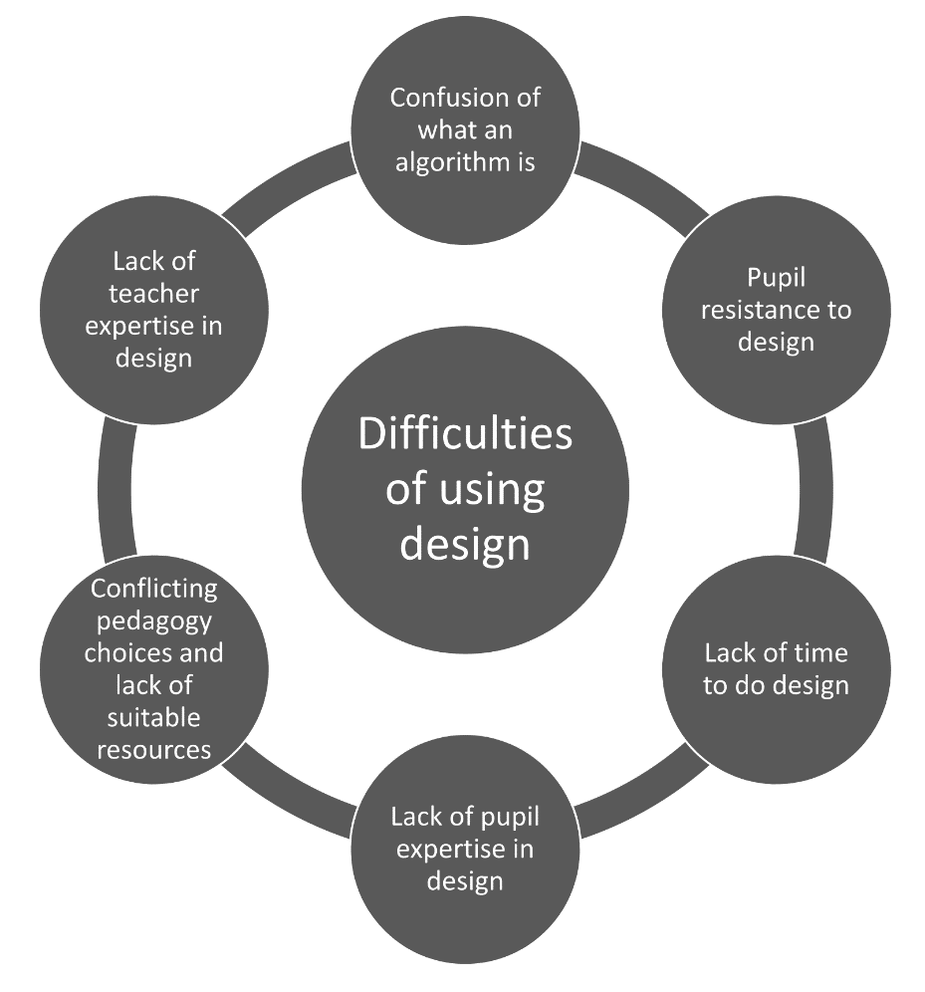
Figure 2: Difficulties with design
(Waite, Curzon, Marsh & Sentence, 2020)
Background and context
Research focus
Method
Findings
Conclusion
Notes:
Our survey revealed 6 main difficulties, a confusion over what an algorithm is, pupil resistace to doing design, a lack of time to do design, a lack of pupil expertise in design, conflicting pedagogies and a lack of resources and a lack of teacher expertise.
The study that we are describing to day Focuses particularly on three elements of difficulties of teacher expertise, confusion of what an algorithm is and confilicting pedagogy and resources and opportunities for developing teacher CPD on design.

Slide 7
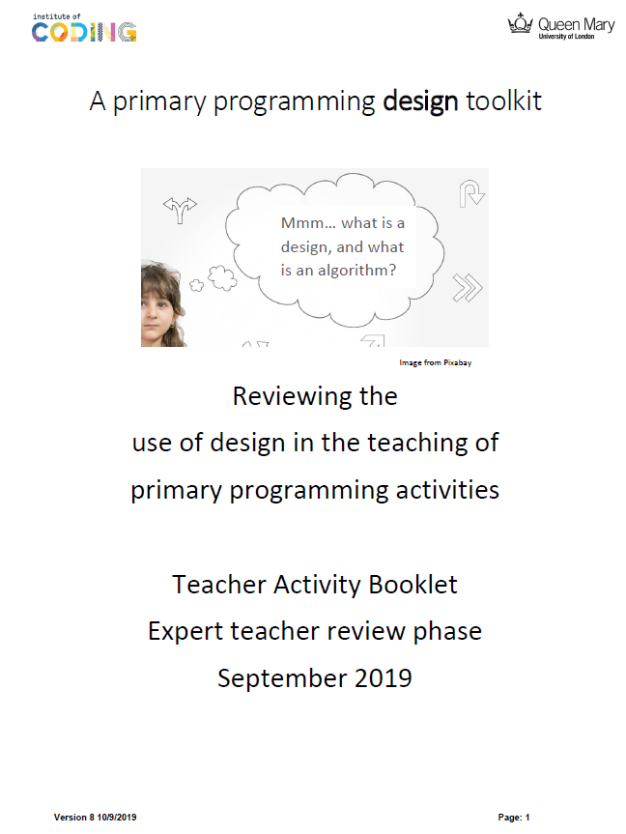
Research focus
To develop CPD to teach the design of programs
the underpinning concepts must be known
have not been defined (Rich, Strickland & Franklin, 2017)
Therefore, we are developing a design toolkit with expert teachers which describes these concepts using
design-based research (Cobb et al., 2003)
and participatory design (Muller & Kuhn, 1993)
This abstract describes the approach taken
Figure 3: Activity Booklet
Background and context
Research focus
Method
Findings
Conclusion
Notes:
So to develop CPD to teach the design of programs
The underpinning concepts must be know, but the reality for is that there has been little research in this area and the concepts have not yet been defined.
Therefore we are c-developing a design toolkit with teachers which describes these concepts using a design based research and participatory design approach
This abstract described the approach taken, the method, rather than the toolkit itself. Although I will share some elements of the toolkit at the end.

Slide 8
Method of creating the toolkit
  Created from a synthesis of
    Literature
    Interview study of 5 teachers & 50 pupils
    Survey of 200+ teachers
  Piloted with teachers in CPD
  Updated based on feedback
  Reviewed by an expert in the field
  Updated based on feedback
  Used by expert group
  Updated based on their feedback
  Reviewed by expert group
  Updated based on feedback
  Shared with a wider audience for feedback
  1st version
  (pilot)
  2nd version
  (post-pilot)
  3rd version
  (expert group)
  4th version
  (expert group
  update)
  5th version
  (final)
Figure 4 Toolkit development
Background and context
Research focus
Method
Findings
Conclusion
Notes:
Step through

Slide 9





Expert group phase
Face to face interviews
28 teachers
(half were female, half male)
Survey used to gather participants
56 teachers registered
Respondents ranked based on expertise
Geographically spread from SW England to Scotland
over 3 months
Saturation approach to stop interviewing (Fusch & Ness, 2015)
Participant Recruitment
Participant Selection
Toolkit use
Saturation
Background and context
Research focus
Method
Findings
Conclusion
Notes:
I am going to step through the recruitment, selection and

Slide 10
Method - interview
Each teacher, using the design toolkit
read about a concept,
observed the concept being applied to sample activity (think aloud protocol),
applied the concept to their own teaching activity (think aloud protocol),
concept was discussed,
suggestions made to improve concept.
Finally,
suggestions made to improve overall toolkit.
Background and context
Research focus
Method
Findings
Conclusion

Slide 11
Findings
All teachers successfully applied each concept to their lesson activity
A range of activities were reviewed, including unplugged lessons, making animations, quizzes, games and using physical computing
Teachers suggested many ways to improve the toolkit including adding extra detail, changing definitions, adding examples and radically changing one particular concept
There was broad agreement that some concepts were more useful to novice teacher than others, but generally that all concepts where useful to experienced teachers developing resources and CPD for others.
Background and context
Research focus
Method
Findings
Conclusion

Slide 12
Conclusions and implications
A set of design concepts have been co-developed.
These could be used
  to review and compare teaching and learning activities
  to guide creation of resources
  as content for CPD
Further research is needed to evaluate the concepts
  the impact of introducing these on pupil progress
  if these concepts are useful beyond the primary English context
Background and context
Research focus
Method
Findings
Conclusion

Slide 13
Design toolkit models and concepts
Today – briefly look at
Two concepts in more detail (Design Format and Design Components)
Design Artefact model

Slide 14






Design formats
Thought
only design
Physical enactment design
With or
without manipulatives
Recorded or
not recorded
Verbal design
Recorded or
not recorded
Drawn design
Written design
Implied design
Sketch
Labels or annotations added to drawn formats
Code
List
Digital image or sound files
Labelled diagram
Storyboard
Notes or lists
Program settings
Concept map
Informal Pseudo code
Flowchart
Other
Other
What are the parts of a design? Is it just the algorithm?
Notes:
Jane going to do this page

Slide 15




Design components (basic building blocks)
Object and data design
What are the names of the objects
that you need?
Object and data design
What objects are needed and what data is to be saved.
E.g. names of the scenes, characters and things that will be controlled and names of data that needs to be saved e.g. score
Algorithm design
What action will occur and its order.
The algorithm controls the objects and data. E.g. a storyboard showing the sequence of movements of the characters, the rules to control a score.
Algorithm design
What do the objects do?
Artwork and sounds design
What you will see and hear.
E.g. a sketch of the
characters, a written description of any voiceovers needed, a list of what music will play.
Artwork and sounds design
What do the objects look and sound like?
Handout 2
Notes:
Matt
Do steps and rules – point to eye and ear and do hand over head for name
Show some examples of Matt’s work
Draw the children back to level 2.

Slide 16
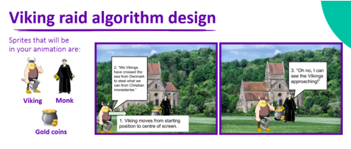
Finding components
Where are the objects?
Where is the artwork?
A list of named characters and the named scene
The images
Where are the algorithms?
Churchyard scene
Characters
Numbered written step,
an arrow and
numbered speech bubbles
Notes:
Matt

Slide 17
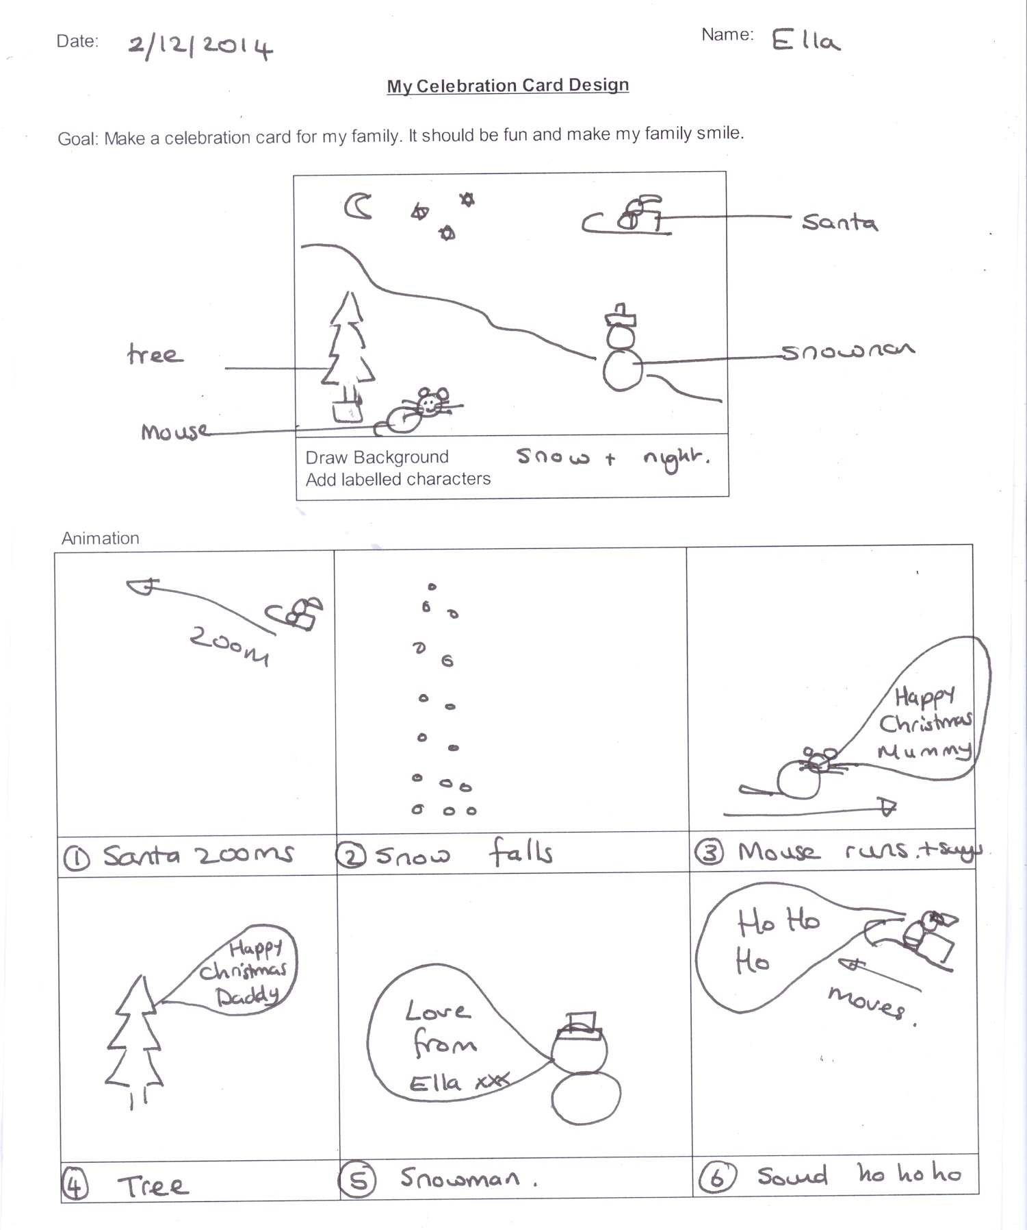
Finding components
Where are the objects?
Where is the artwork?
Where are the algorithms?
Handout 3
Notes:
Matt

Slide 18




































Requirements Artefact
Teaching & Learning Artefact
Design Artefact
Figure 8 Design artefact model and other concepts
is represented by one or more
may incorporate one or more
is of an
takes account of
Design Component
Common Design Patterns
Activity Genre
Levels of abstraction
Task, Design, Implementation, Running
(Inc. algorithm) the program
1st
is used for one or more
Design Uses
is or is not known about through
is developed as part of one or more
Students awareness
Design Activities
is expressed in a
is developed using a
is refined through a
is supported and constrained by
Draft version, not for publication.
Design Format
Design Approach
Design Refinement
Process
Scaffolding Techniques

Slide 19
Questions and Answers
j.l.waite@qmul.ac.uk @janewaite
#ccers20

Slide 20
Please help us with our research
https://www.surveymonkey.co.uk/r/ResearchPlacementsOutreach
Do you
Teach computing
Develop computing resources (including CPD)
Work in initial teacher training (secondary CS or primary)
Undertake CS education research
Run CS university modules with school placements
Provide CS outreach
How teachers engage with research?
How schools engage with universities and vice versa?
Survey by Computing At School Research Working Group, BCS, Raspberry Pi Foundation, Council of Professors and Heads of Computer science (CPHC), Queen Mary University of London

Slide 21
#CSEdResearchBookClub
https://www.surveymonkey.co.uk/r/ResearchPlacementsOutreach
Every 1st Thursday of the Month
Twitter and trying a hangout and a collaborative google doc this month
This months read
Identifying student misconceptions of programming (Kaczmarczyk et al. 2010) http://publish.illinois.edu/glherman/files/2016/03/2010-SIGCSE-Programming-Misconceptions.pdf
Next month reading research about distance learning - please add ideas https://tinyurl.com/CSEdResearchBookClub

Slide 22
Bibliography
Cobb, P., Confrey, J., diSessa, A. A., Lehrer, R., & Schauble, L., 2003. Design experiments in educational research. Educational Researcher, 32(1), 9-13. doi: 10.3102/0013189X032001009
Department for Education, 2013. Computing programmes of study key stages 1 and 2 National Curriculum in England Retrieved from: https://www.gov.uk/government/publications/
national-curriculum-in-england-computing-programmes-of-study..
Falkner, K., Vivian, R., 2015. A review of computer science resources for learning and teaching with
k-12 computing curricula: An Australian case study. Computer Science Education 25, 390–429.
doi:10.1080/08993408.2016.1140410.
Fusch, P. I., & Ness, L. R., 2015. Are We There Yet? Data Saturation in Qualitative Research. The Qualitative Report, 20(9), 1408-1416. Retrieved from https://nsuworks.nova.edu/tqr/vol20/iss9/3
Kuckartz, U., 2014. Qualitative text analysis: A guide to methods, practice and using software Sage
Muller, M. J., & Kuhn, S., 1993. Participatory design. Communications of the ACM, 36(6), 24-28 doiI: 10.1145/153571.255960

Slide 23
Bibliography
Rich, K., Strickland, C., Franklin, D., 2017. A literature review through the lens of computer science
learning goals theorized and explored in research, in: Proceedings of the 2017 ACM SIGCSE Technical
Symposium on Computer Science Education, ACM, New York, NY, USA. pp. 495–500. doi:10.1145/
3017680.3017772.
Waite, J.,2017. Pedagogy in teaching computer science in schools: A literature review (after the reboot:
computing education in uk schools). Online. URL: https://royalsociety.org/~/media/policy/
projects/computing-education/literature-review-pedagogy-in-teaching.pdf.
Waite, J., Curzon, P., Marsh, W., Sentance, S., 2018. Comparing K-5 teachers’ reported use of design
in teaching programming and planning in teaching writing, in: Proceedings of the 13th Workshop in
Primary and Secondary Computing Education. doi:10.1145/3265757.3265761.
Waite, J., Curzon, P., Marsh, W. D. & Sentance, S., 2020. Difficulties with design: The challenges of teaching design in K-5 programming. Computers & Education, Volume 150, 2020,103838,ISSN 0360-1315, https://doi.org/10.1016/j.compedu.2020.103838.

Slide 24
Primary Programming Activity
Requirements
artefact
Design
artefact
Implementation artefact
Running the program artefact
Teaching and learning resource artefact
Draft version, not for publication.
Figure 5 Primary programming activity artefact model

Slide 25
Design Artefact
Figure 6 Design artefact model
is represented by one or more
may incorporate one or more
Design Component
Common Design Patterns
1st
is used for one or more
Design Uses
is or is not known about through
is developed as part of one or more
Students awareness
Design Activities
is expressed in a
is developed using a
is refined through a
is supported and constrained by
Draft version, not for publication.
Design Format
Design Approach
Design Refinement
Process
Scaffolding Techniques

Slide 26


Object and data design
What objects are needed and
what data is to be saved. E.g. names of the scenes, characters and things that will be controlled and names and type of data that needs to be saved e.g. score (number).
Algorithm design
What action will occur and its order.
The algorithm controls the objects and data. E.g. a storyboard showing the sequence of movements of the characters, the rules to control a score.
Artwork and sounds design
What you will see and hear.
E.g. a sketch of the
characters, a written description of any voiceovers needed, a list of what music will play.
Physical structure and mechanical design
What DT is needed i.e. the physical structures and mechanical properties of the design E.g. a labelled drawing of the body, chassis and axle, wheels and motors for a robot toy.
Electronics design
What the electronic parts are and how they
will be connected. E.g. the wiring diagram for the controller, lights, sensors and motor for a robot toy.
Figure 7 Design component concept
Draft version, not for publication.

